Slide 1



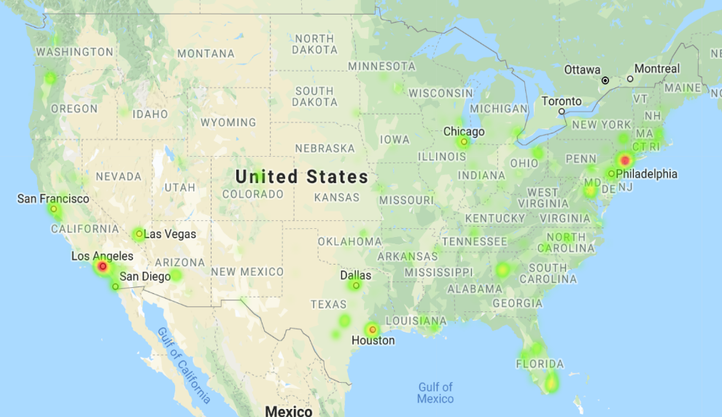
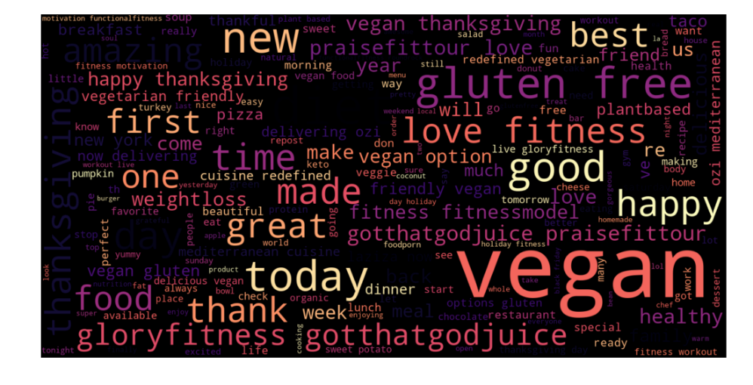
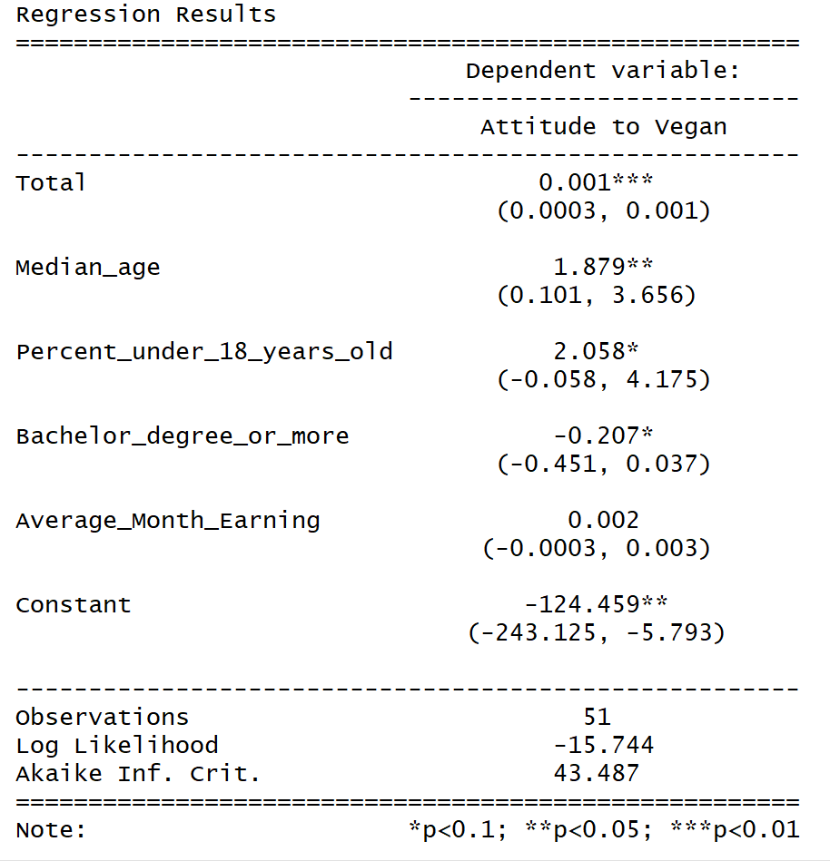
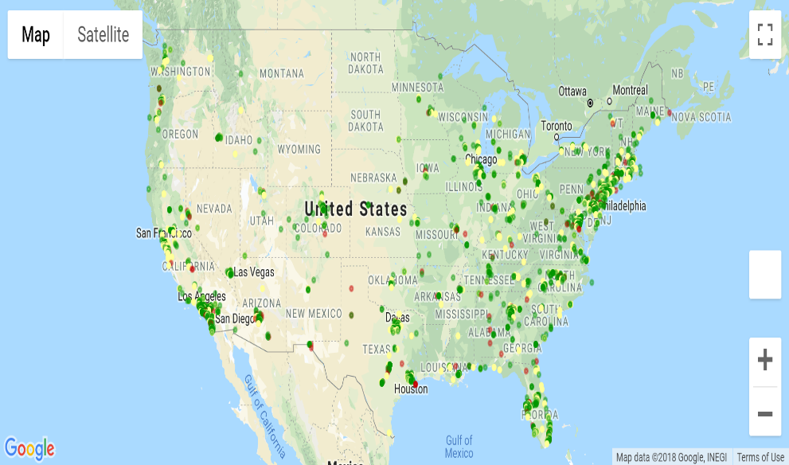
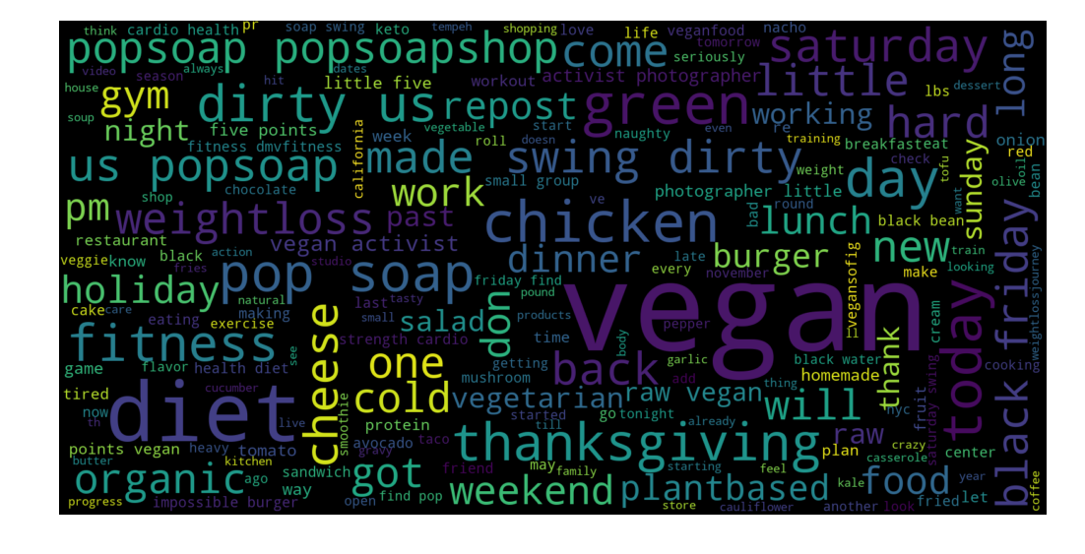
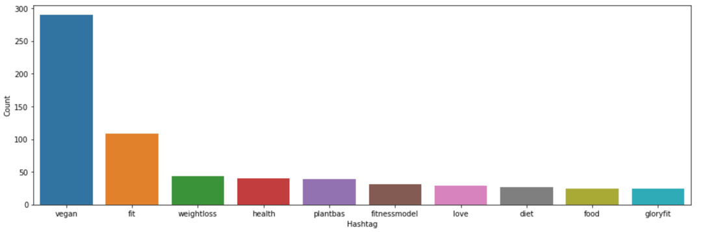
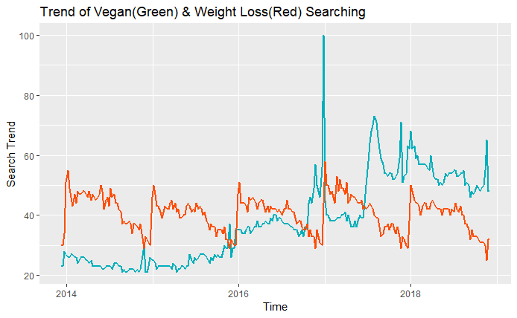
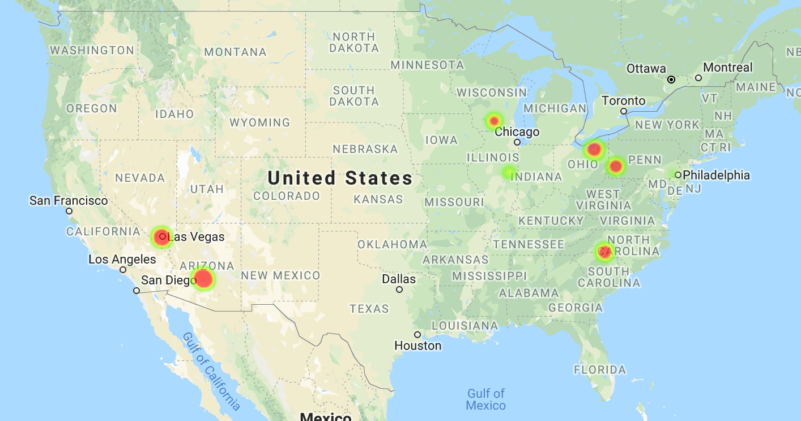
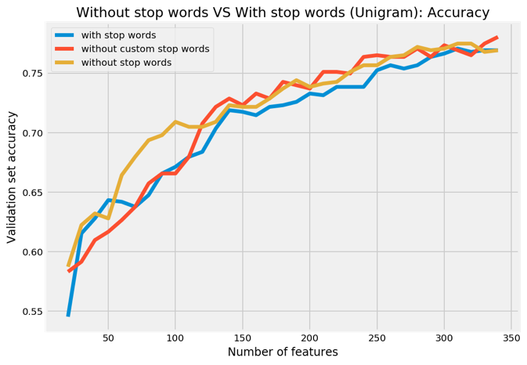
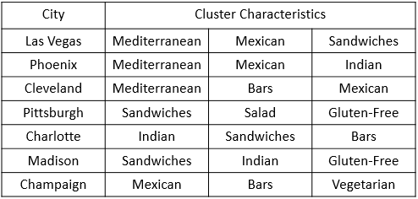
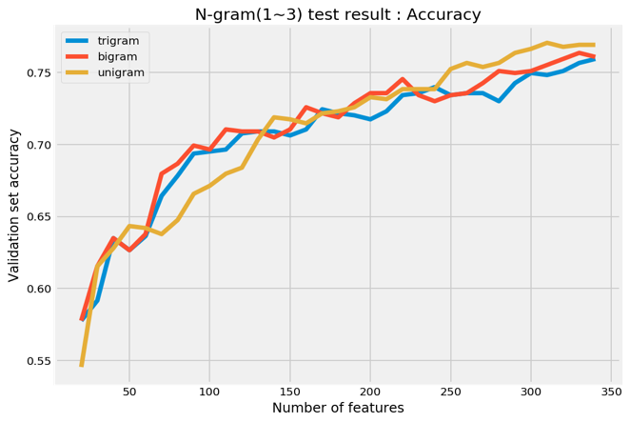
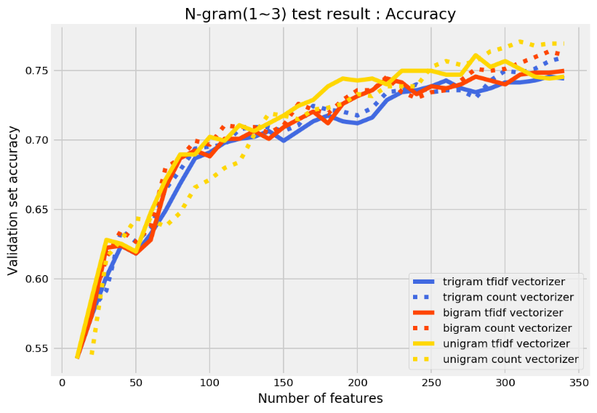


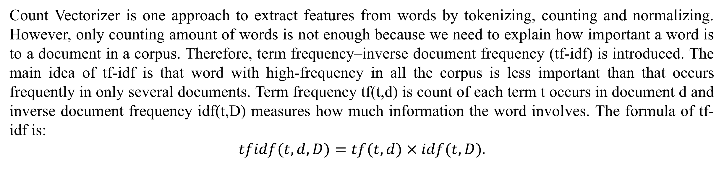
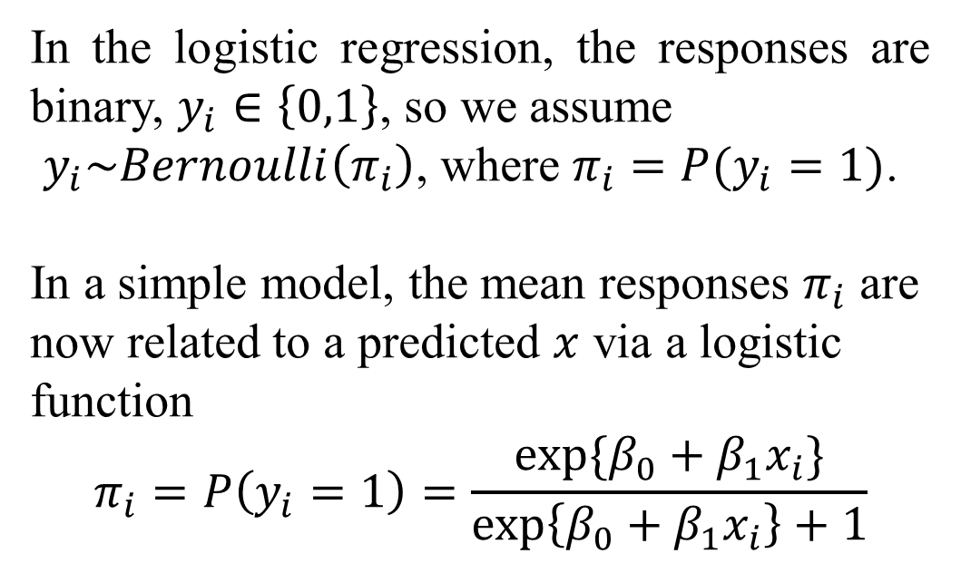
Conscioux Internet Market Research
$Huaiyu Hu^{1}$ ${Keer Jiang}^{1}$ $Yuning Xie^{2}$
1. Dept of Mathematics & Statistics, Boston University 2. College of Engineering, Boston University
Abstract
Data Cleaning and Visualization
Regression
In this project, our objective is to locate potential markets for Conscioux by taking insight of people's attitude towards veganism in Twitter. To be more precise, we are interested in the supply and demand of vegetarian. The two main datasets we use are the data containing terms “vegan” and “weight loss” scraped from Twitter and public Yelp dataset. To have a general view of how these tweets distribute across the country, we plot the locations of these tweets on Google Map. At the same time, we also visualize the distribution of restaurants that provide vegetarian by clustering with Yelp data. With the preprocessed tweets data, we compare several models that classify the sentiment based on one’s tweet. To explore other factors that may affect people’s attitude towards vegan, significant factors are achieved by logistic regression.
The upper map shows the location distribution of all the tweets that contain the terms “vegan” and “weight loss”. It is clear to see that these tweets are concentrated in New York metropolitan area , Los Angeles, San Francisco, Houston and Orlando. It is reasonable that metropolis with larger population density would like to try a plant-based diet and healthier lifestyle. Thus we recommend Conscioux to advertise more and help potential customer in these cities to switch to vegan lifestyle.
In the logistic regression, the responses are binary, $y_{i}∈\left\{0,1\right\}$, so we assume
$y_{i}\sim Bernoulli\left(π_{i}\right)$, where $π_{i}=P(y_{i}=1)$.
In a simple model, the mean responses $π_{i}$ are now related to a predicted $x$ via a logistic function
$$π_{i}=P\left(y_{i}=1\right)=\frac{exp\{β_{0}+β_{1}x_{i}\}}{\exp\left\{β_{0}+β_{1}x_{i}\right\}+1}$$
To explore the factors that may affect people’s sentiment towards vegan lifestyle in 50 states, we choose total population, sex proportion, median age, the percentage of people under 18 years old, the percentage of people have Bachelor degree or more, average monthly earning, adult obesity rate and number of restaurants in each state, and each row is for one state. The binary response variable is created by summing up all the sentiment in one state and we determine that the top 30% of the states have the overall sentiment of 1 and the rest have the overall sentiment of 0.
In the second map, green/yellow/red means positive/neutral/negative attitudes respectively. There some areas that discuss about vegan a lot with many green/yellow points and they could be the targeted people of Conscioux. For example, Chicago and Florida are good examples of under-served areas.
Introduction
One straightforward text visualization is the controversial word cloud. A word cloud represents word usage in a document by resizing individual words proportionally to its frequency, and then presenting them in random arrangement. The word clouds of positive(upper) and negative sentiment are shown on the right. It is quite obvious that the most of the words in positive word cloud are related to healthier lifestyle and many words in negative word cloud are related to junk food.
Veganism was created to describe the group that hold the belief of abstaining from the use of animal products, particularly in diet. The follower of this kind of diet or philosophy is known as a vegan. According to the trend of searching “vegan”(green) and “weight loss” (red) from Google, we can prove that the concept of vegan lifestyle is favored across the United States has ballooned. Meanwhile, healthy balance attracts attention of more Americans, especially in the aspects of carbohydrates, fats, and proteins considering body status.
After applying AIC algorithm, we build the logistic regression model that obtains four significant variables, which are total population in one state, median age, the percentage teenagers, the percentage of people have Bachelor degree or more and average monthly earning. The coefficients in model summary provide useful information about relationship between sentiment and these factors. For example, as median age increase by one unit and other variables remain the same, the positive sentiment being more likely to occur. By using the model to classify sentiment we get the precision of 0.8 and recall of 0.667.
Hashtags in Twitters are synonymous with the ongoing trends on Twitter at any particular point in time. As expected, most of the terms are positive and relevant to healthy lifestyle, such as fit, weight loss, health and so on. Thus, Conscioux should focus on these keywords when advertising, which attracts more attention from consumers.
Feature Extraction and Model Building
Clustering with Yelp
Conscioux is aim to provide a one-stop shop for plant-based health solutions for weight loss, muscle gain, and nutritional guidance. Customers are easily connected to programs and professionals that share their healthy living values.
Count Vectorizer is one approach to extract features from words by tokenizing, counting and normalizing. However, only counting amount of words is not enough because we need to explain how important a word is to a document in a corpus. Therefore, term frequency–inverse document frequency (tf-idf) is introduced. The main idea of tf-idf is that word with high-frequency in all the corpus is less important than that occurs frequently in only several documents. Term frequency tf(t,d) is count of each term t occurs in document d and inverse document frequency idf(t,D) measures how much information the word involves. The formula of tf-idf is:
$$tfidf(t, d, D)=tf(t, d) × idf(t, D).$$
The original data includes 26 states in United States. However, after selecting vegan or vegetarian as keywords, we only have data from 8 states including AZ, IL, NC, NV, OH, PA, SC, WI. The left map shows Las Vegas and Phoenix have the largest number of vegetarian restaurants. In order to find the key characteristics of each vegetarian region, we use k-means++ for clustering. To define the number of clusters, we use error and silhouette scores. The left table is the top 3 concepts of each clusters.
Data Collection
There are three datasets analyzed in this project and the first one to analyze demand is scraped from Twitter. Choosing “vegan” and “weight loss” as our keyword, we collect tweets, tags, coordinates (longitude & latitude), favorite count and country code. It is necessary for us to analyze coordinates, so after filtering out, the number of observations with exact location is 3574. Natural language processing and sentiment analysis is used to quantify reviews with “1”, “0” and “-1” which means positive, neutral and negative attitude respectively. The percentage of positive, neutral and negative attitude towards vegan are 54.34%, 34.61% and 11.05%. In total, the reaction is satisfied and the space for Conscioux to develop their consumers is considerable.
In using count vectorizer for feature extraction, we first check whether stop words need to be removed. We run the same test with stop words, without stop words and without the top 10 frequent stop words that we define to compare the results. The classification model we choose to evaluate different count vectors is logistic regression where 0 stands for neutral sentiment and 1 stands for positive sentiment. From the upper plot we can see that the data without stop words gives us the best classification performance.
Furthermore, we also compare the performance of N-grams where N takes 1,2 and 3. N-grams are simply all the combinations of adjacent words or letters of length n that can be found in the text. The middle plot shows the the performance of unigram, bigram and trigram where we can see that unigram performs slightly better than other two.
Conclusion
Based on the results before, we provide these advice for Conscioux:
There are potential customers are mainly located by the yellow points in the second map, thus they should focus more on cities like NYC, LA, Houston and Orlando.
Given the tweets of one user, his/her sentiment could be estimated using the model built before.
Based on the cluster characteristics and hashtags, related keywords should be used when advertising, e.g. gluten-free for Pittsburgh.
Focus on districts with higher population, higher median age, higher teenager percentage, lower percentage of Bachelor degree or more and higher average monthly earning.
The second dataset is from Yelp including business set and review set. After picking “vegan” and “vegetarian” as key words, the number of observations after filtering out is 1411. The last dataset will be mentioned in the section of logistic regression.
Once we instantiate Tfidf vecorizer and fit the transformed data to logistic regression, and then check the validation accuracy for a different number of features. Based on the plot below, we can see that count yields better result than tfidf vectorizer and unigram performs better than bigram and trigram. With the help of this model, we can predict attitude of customer more accurately.
Acknowledgement
Silvia Tower, CEO of Conscioux provides framework and suggestions for us.
The techniques used in this project are based on CS 506 taught by Andrei Lapets.
BU SPARK! provides us the chance to present our work.

